Slide 1
B Sharp
Anonymous Narwhal

Slide 2
Team Members and Roles
Nick Morris: Database
Cameron Keith: Database
Chris Linstromberg: Database
Robert Stewart: GUI
Guy Cockrum: GUI
Ryan Tanner: Database & GUI

Slide 3
Project Idea
Sheet Music Organizer/Music Database
“Provide an easy way for band directors to manage their ‘performers’ and music while granting easy access to music used by the ‘performers’”
Notes:
Project Idea will probably overlap with some other sections
a. implement a three-tiered software architecture
b. provide a web site/web application and native android UI client
c. Equally draw upon the disciplines taught in both CSE 3330 and 3345
d. Be deemed appropriate for Academia
e. Create anything

Slide 4
Project Idea
Android
Quick viewing anytime, anywhere
Website
Central Hub for sheet music uploading and viewing
Directors can manage their band’s music easily with a user friendly interface
A three-tiered architecture
Abstracts away how music is stored/accessed
Notes:
We need to shrink our slides. Let’s put our full version in the comments and paraphrase more in the slides.
Android
User can use the app to navigate through sheet music for their band
Can view or download sheet music on the user’s phone
Website
Central Hub for music uploading and viewing
(suggests a director can have more than one band) Directors can manage their bands’ music easily with a user friendly interface

Slide 5
Product Features
Dual User based System
Director
Performer
Register and log in
Log in with Facebook and Google
Upload sheet music as .pdf
Ability to print and view .pdfs on website
Organize band members and assign parts
Assign music to band members based on parts
Notes:
http://ec2-54-234-87-100.compute-1.amazonaws.com/docs/proposal.pdf
Check how they listed the features. What you have written is alright to say out loud, but on the slide they will only want to see the features.

Slide 6
Intended Users
Any group needing to distribute sheet music reliably through their users
Marching Bands
Concert Bands
Choir
Orchestra
Pipe Bands
Church Music Groups

Slide 7
Market Analysis
Competitors
MusicLibrarian.net
RCI Software

Slide 8
Market Analysis
MusicLibrarian.net
no software installation/maintenance
sheet music tracking
member browsing
librarian updates
free usage
for bands, orchestras and choirs

Slide 9
Market Analysis
RCI Software
tracking (music, composers, arrangements, performers, loaned materials, etc)
general administrative site
for bands, orchestras and choirs

Slide 10
Market Analysis
Weaknesses
MusicLibrarian.net
-- 180+ users
-- general member permissions only include browsing

Slide 11
Market Analysis
Weaknesses
Riden Consulting, Inc.
-- software upgrades - $60 plus $5
S&H
-- clunky GUI (not very attractive or user friendly)
-- small market share

Slide 12
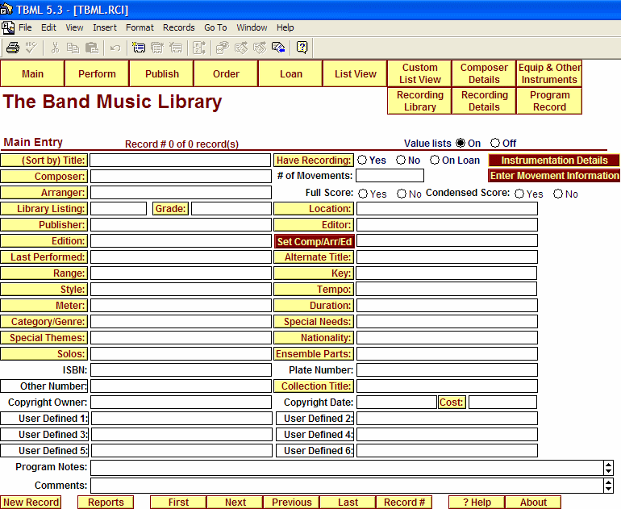

Slide 13
Market Analysis
Our Advantages
web-based
more permissions for performers
elegant, efficient GUI
larger share of market
How do we achieve a larger share?

Slide 14
Marketing Analysis
Strategy
Drum Corps International
music conventions
-- Texas Music Educators
Association
-- Midwest Clinic
Marketing here -- GREATLY increases visibility in music world.

